Slide 1
ns-3 Training
Visualization
ns-3 Annual Meeting
June 2016

Slide 2
Overview
No preferred visualizer for ns-3
Several tools have been developed over the years, with some scope limitations
Pyviz
FlowMonitor (statistics with Pyviz linkage)
NetAnim (George Riley and John Abraham)

Slide 3
PyViz overview
Developed by Gustavo Carneiro
Live simulation visualizer (no trace files)
Useful for debugging
mobility model behavior
where are packets being dropped?
Built-in interactive Python console to debug the state of running objects
Works with Python and C++ programs

Slide 4
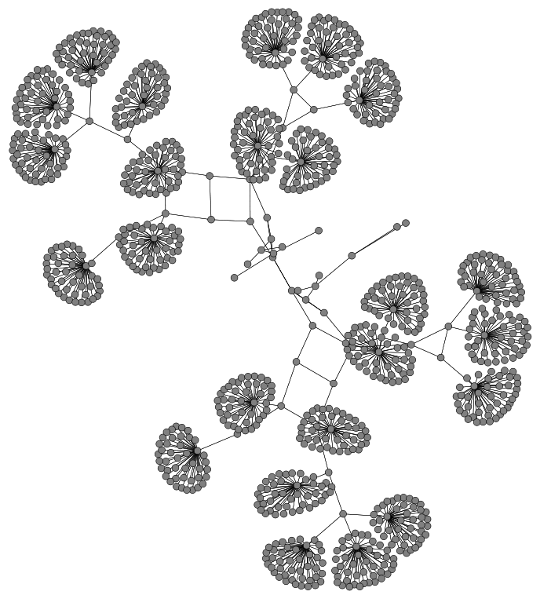
Pyviz screenshot (Graphviz layout)

Slide 5
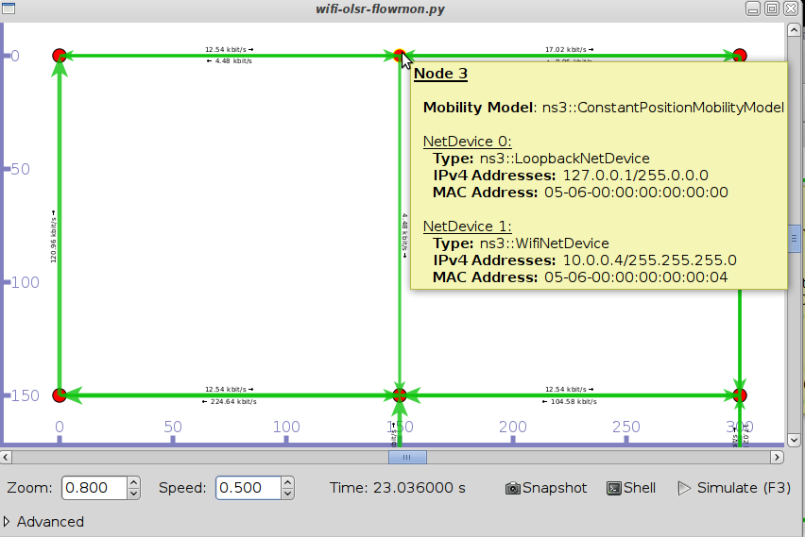
Pyviz and FlowMonitor
src/flow-monitor/examples/wifi-olsr-flowmon.py

Slide 6

Enabling PyViz in your simulations
Make sure PyViz is enabled in the build
If program supports CommandLine parsing, pass the option
--SimulatorImplementationType=
ns3::VisualSimulatorImpl
Alternatively, pass the "--vis" option

Slide 7
FlowMonitor
Network monitoring framework found in src/flow-monitor/
Goals:
detect all flows passing through network
stores metrics for analysis such as bitrates, duration, delays, packet sizes, packet loss ratios
G. Carneiro, P. Fortuna, M. Ricardo, "FlowMonitor-- a network monitoring framework
for the Network Simulator ns-3," Proceedings of NSTools 2009.

Slide 8
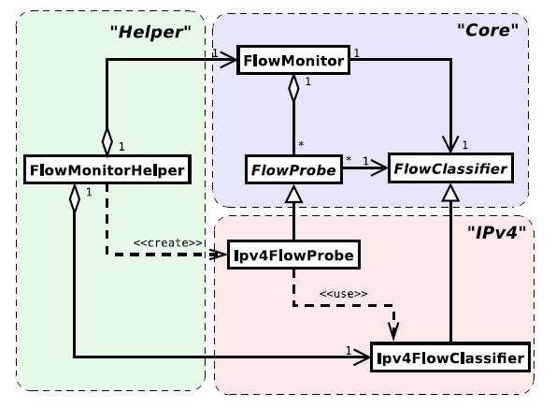
FlowMonitor architecture
Basic classes
FlowMonitor
FlowProbe
FlowClassifier
FlowMonitorHelper
IPv4 and IPv6
Figure credit: G. Carneiro, P. Fortuna, M. Ricardo, "FlowMonitor-- a network monitoring
framework for the Network Simulator ns-3," Proceedings of NSTools 2009.

Slide 9
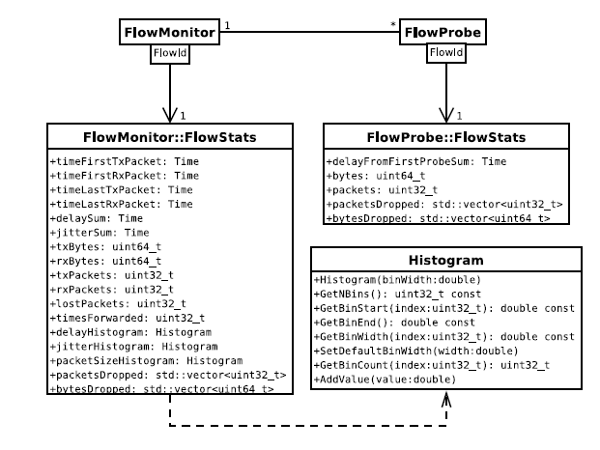
FlowMonitor statistics
Statistics gathered

Slide 10
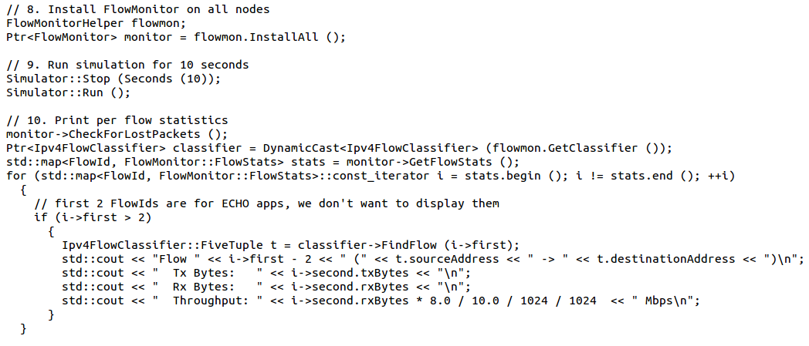
FlowMonitor configuration
example/wireless/wifi-hidden-terminal.cc

Slide 11
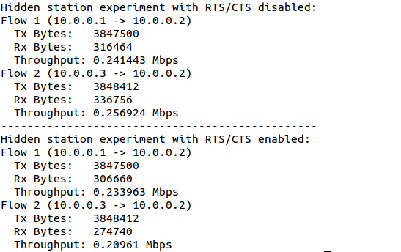
FlowMonitor output
This program exports statistics to stdout
Other examples integrate with PyViz

Slide 12
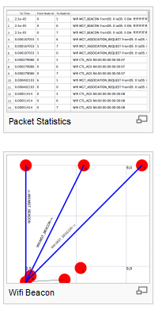
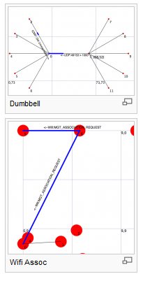
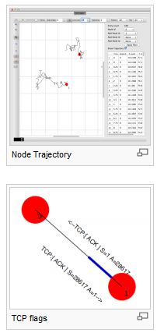
NetAnim
"NetAnim" by George Riley and John Abraham
pyviz

Slide 13
NetAnim key features
Animate packets over wired-links and wireless-links
limited support for LTE traces
Packet timeline with regex filter on packet meta-data.
Node position statistics with node trajectory plotting (path of a mobile node).
Print brief packet-meta data on packets

